Slide 1

Bharadwaj Vavilikolanu (Lead)
Kiran Kumar Jonnada
Reddy Bhanu Prakash

Slide 2
About Lending Club
It is the world’s largest online credit marketplace.
They facilitates
personal loans,
business loans, and
financing for elective medical procedures.

Slide 3
What They Do
Borrowers access lower interest rate loans through a fast and easy online or mobile interface.
Investors provide the capital to enable many of the loans in exchange for earning interest.

Slide 4
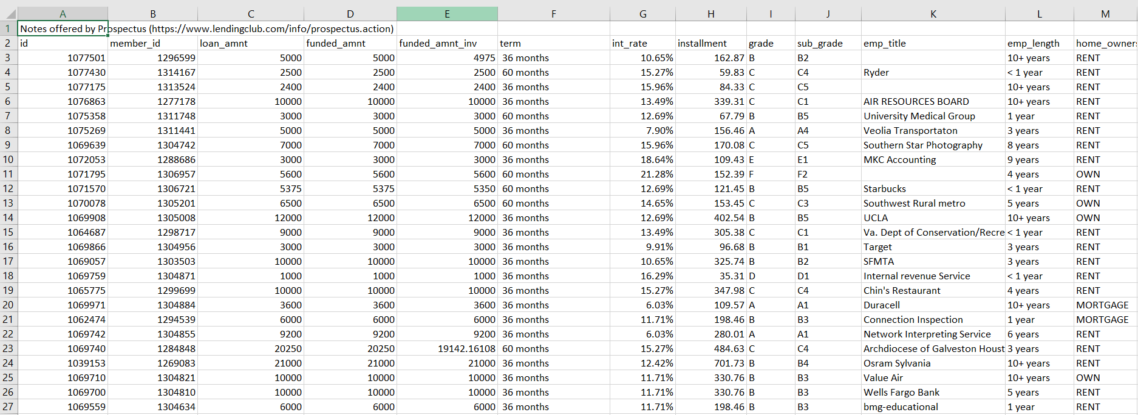
Sample Dataset

Slide 5
Dimension Tables
BorrowerDimension
BorrowerID(PK)
Borrower_Title
Borrower_Grade
Borrower_Homeowner
LocationID(FK)
Borrower_Zip_code
AnnualIncome
Loan
LoanID(PK)
LoanDescription
LoanTerm
Purpose
ApplicationType
TimeDimension
IssuedateID(PK)
Time_Day
Time_Month
Time_Year
Location
LocationID(PK)
State_name
A dimension table stores attributes, or dimensions, that describe the objects
in a fact table.

Slide 6
Fact Table
LoansFact
LoanID
BorrowerID
TimeID
LoanAmount
LoanAmountAlloted
InterestRate
The fact table lists events that happen in the company (or at least the events that
we want to analyze). The dimension tables list the factors (Borrower, Time, Investor etc.,)
by which we want to analyze the data.

Slide 7
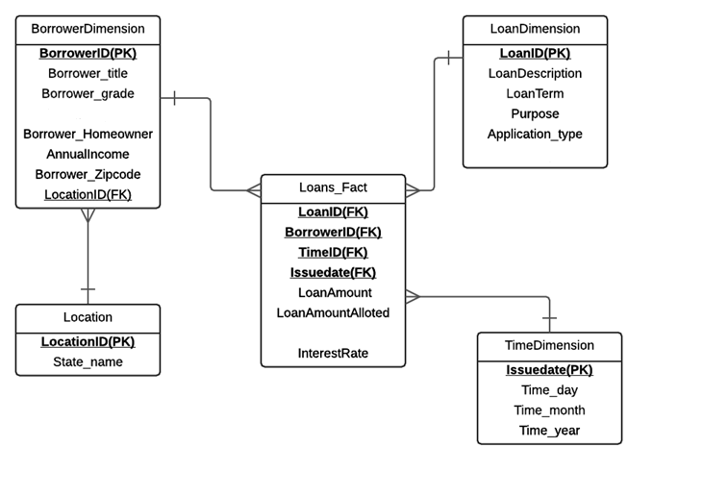
Snow Flake Schema

Slide 8
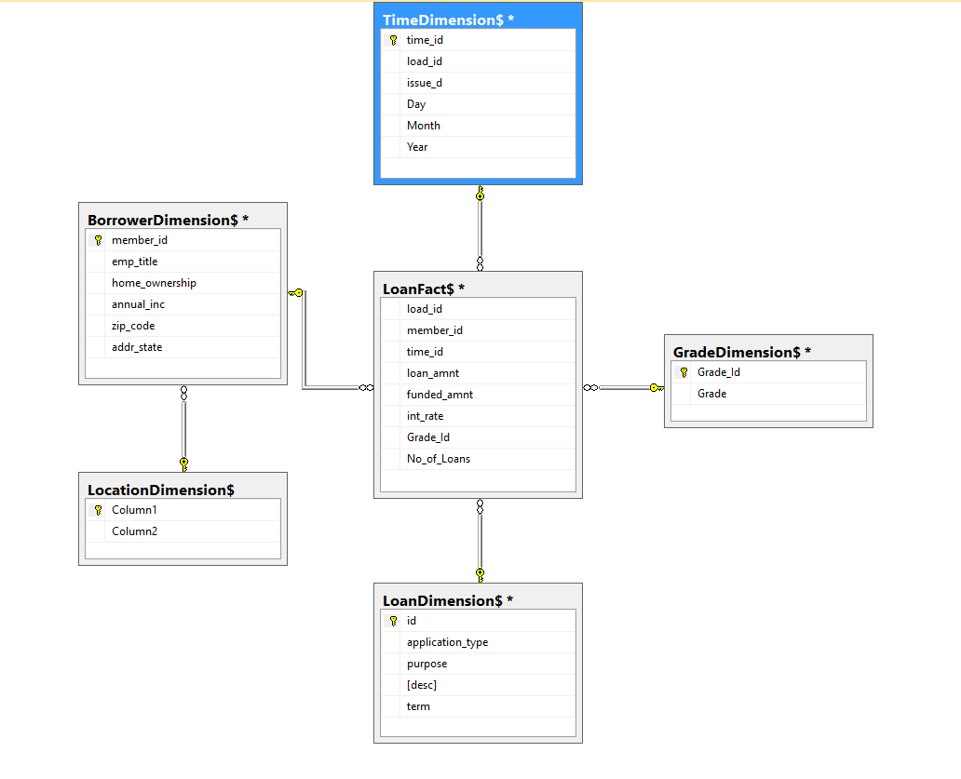
Dimensional Modelling

Slide 9
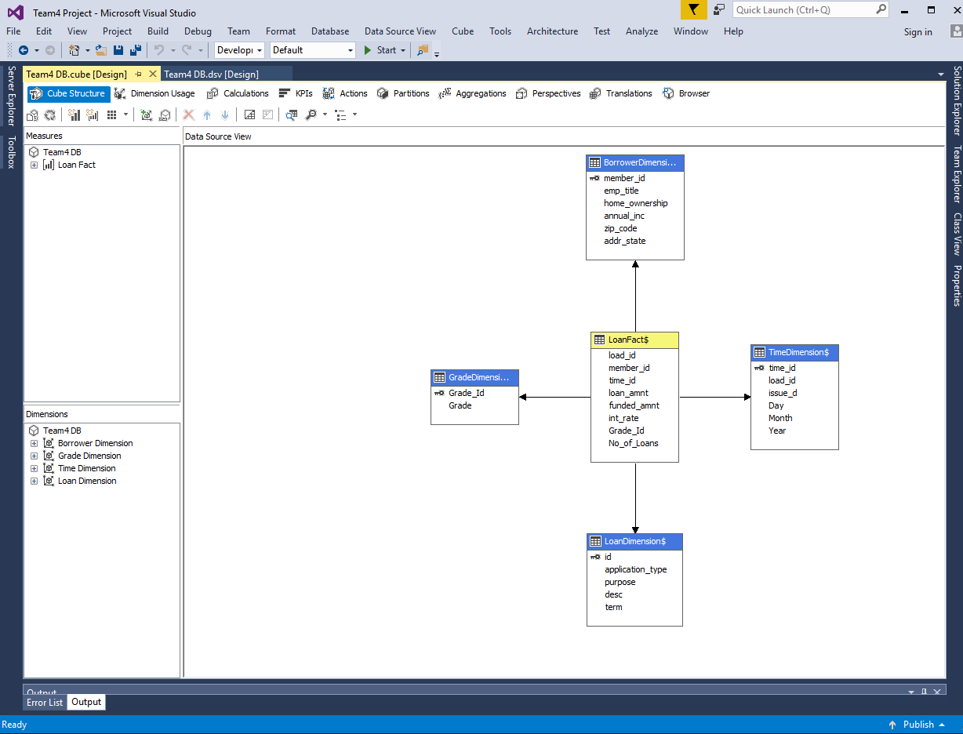
Cube Development in Visual Studio

Slide 10
Reports generated using Excel:
1. Report based on Grade.
2. Report based on Purpose.
3. Report based on State.

Slide 11
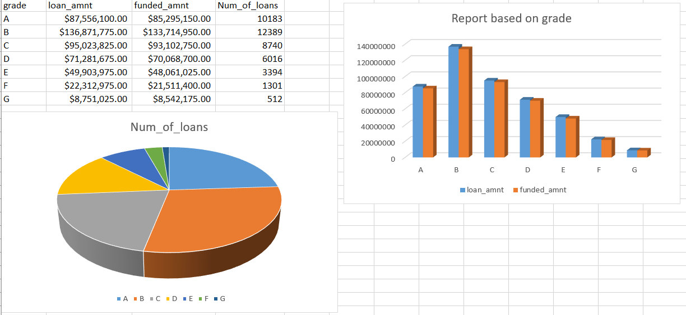

Slide 12
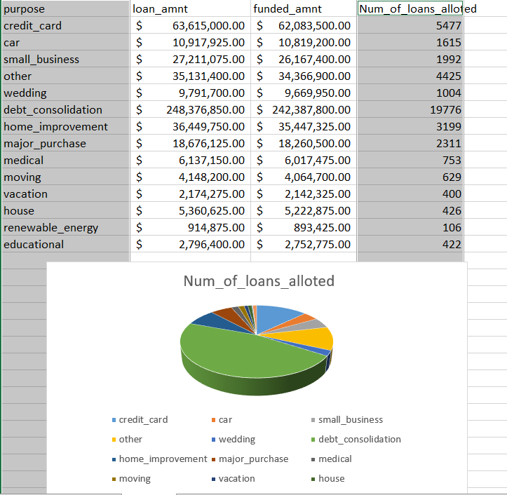

Slide 13
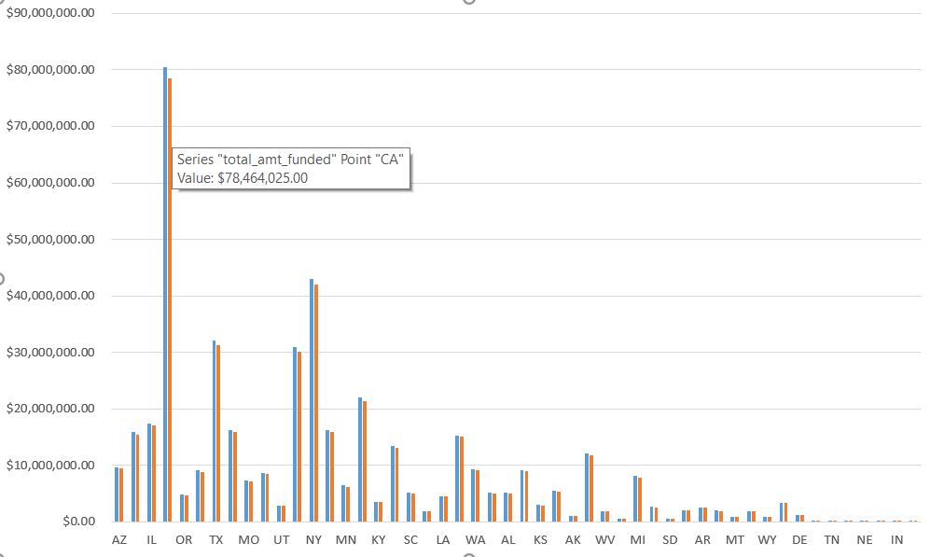

Slide 14
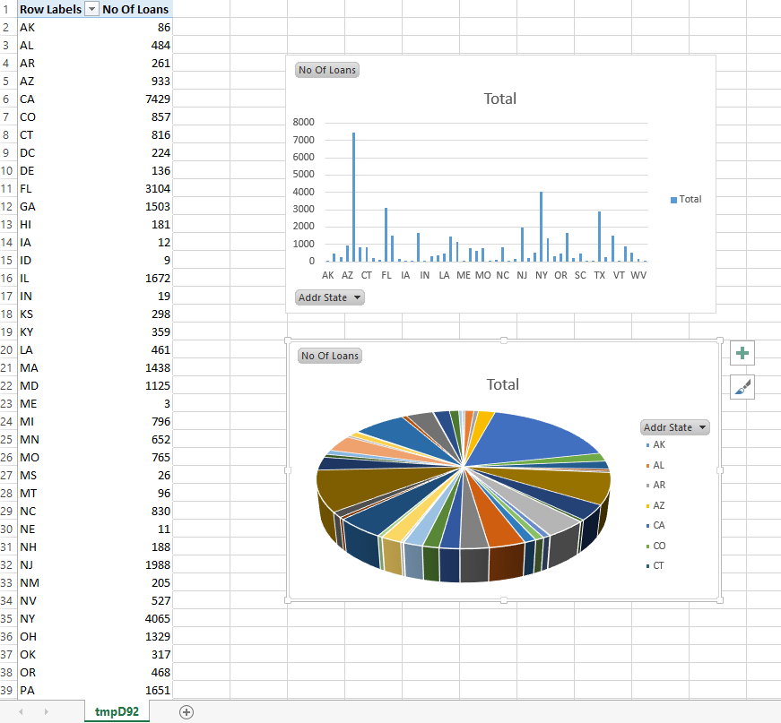
Cube Reports - Report by State

Slide 15
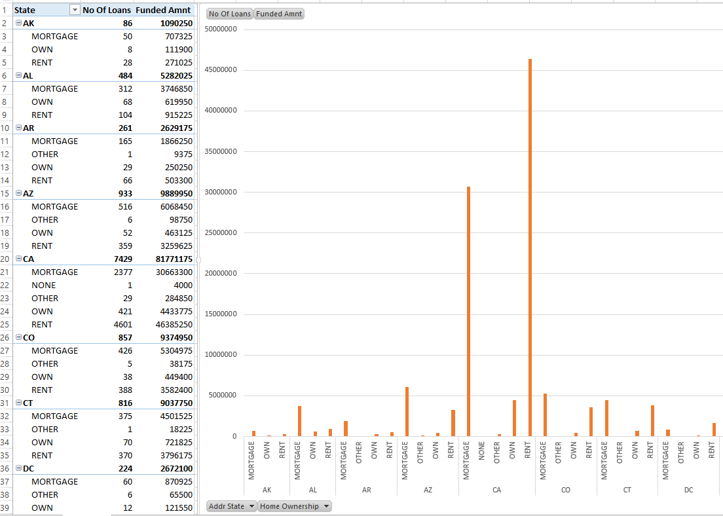
Report based on state and borrower home ownership

Slide 16
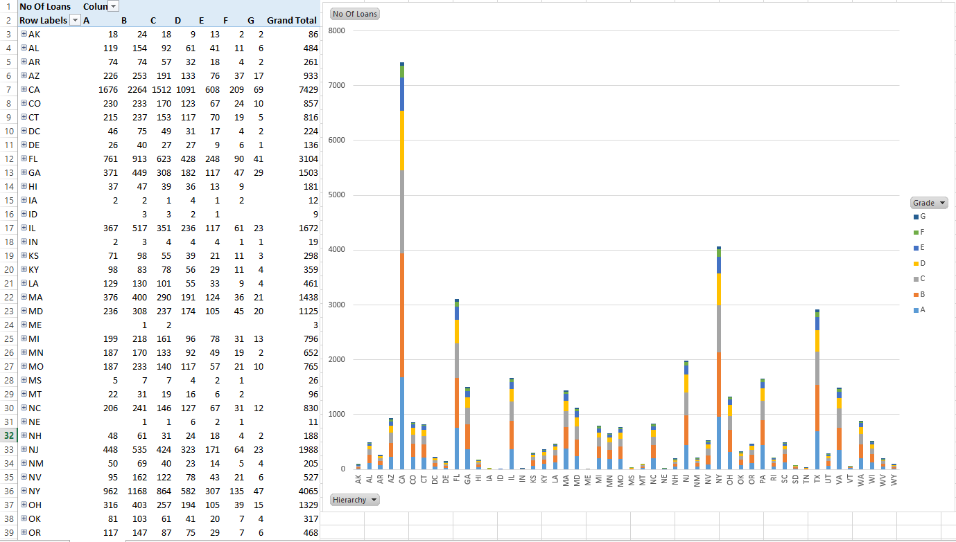
Report on number of loans based on grade and state

Slide 17
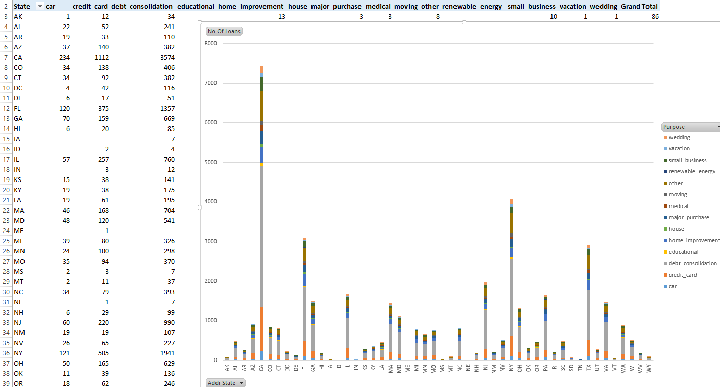
Report based on loan purpose in each state

Slide 18
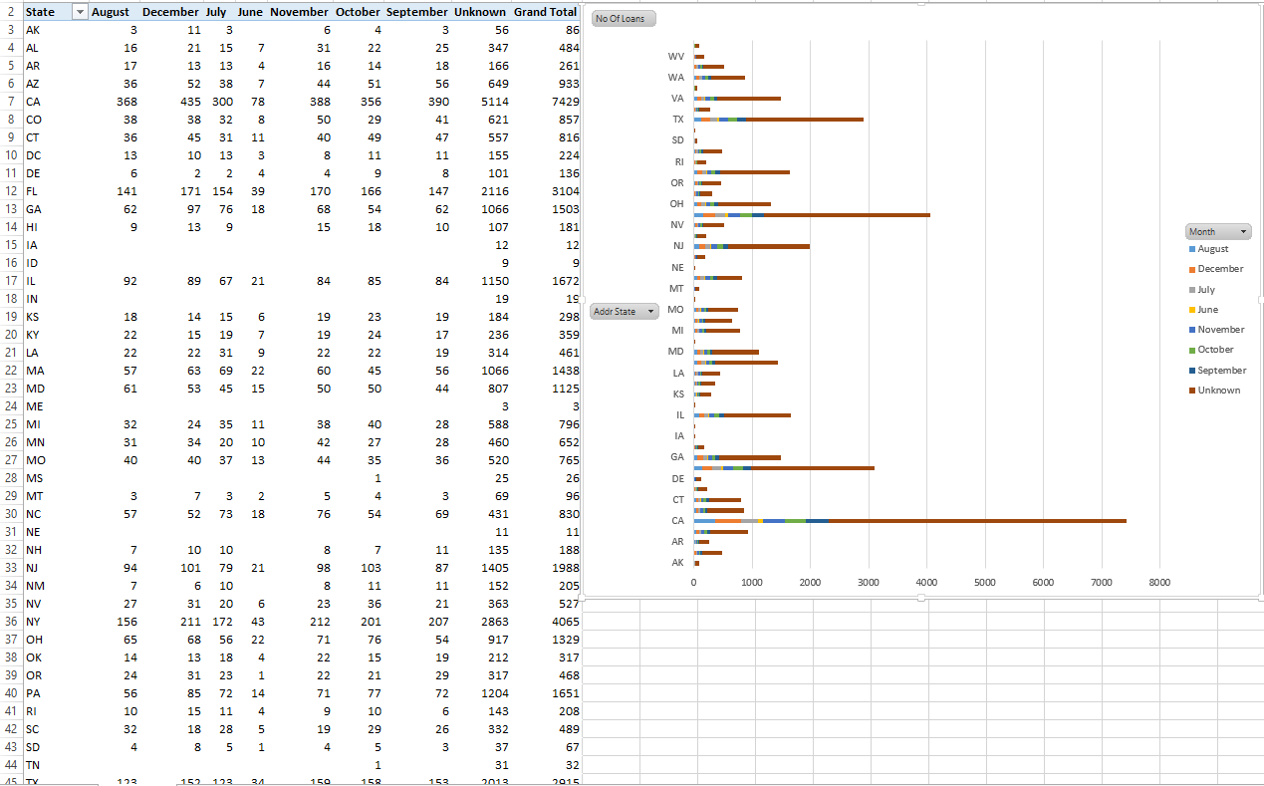
Report on number of loans based on each month by state

Slide 19


